Slide 1
Music Generation
Week Four

Slide 2
YOU MADE IT!

Slide 3
Questions?
What do you guys need help catching up with or have questions about?

Slide 4
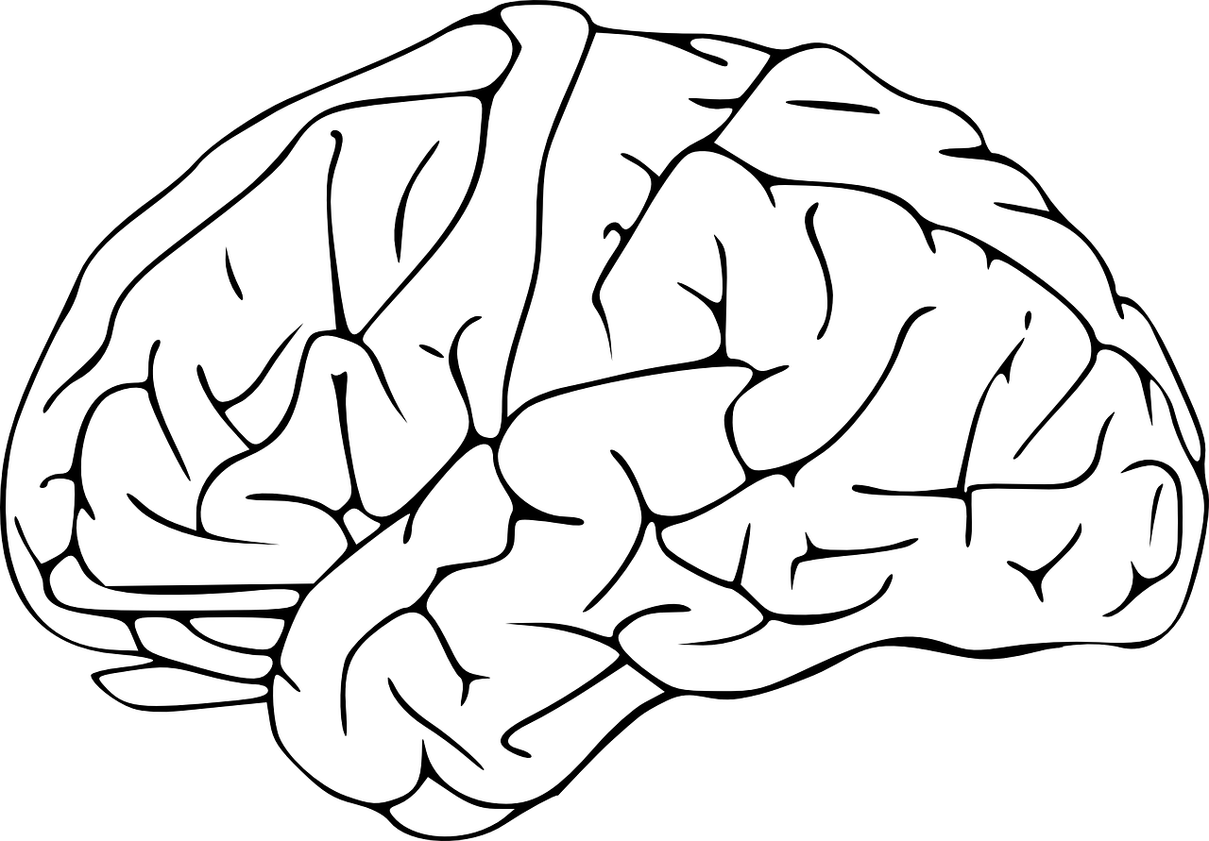
What we’re doing this week:
Finally generating the melody you’ve been working on!
NoteSequences
TRAIN
TRAIN
TRAIN
Beautiful
Music
(hopefully)
SequenceExamples

Slide 5
Last Week Recap
Last week we trained our model using the SequenceExamples we generated from our NoteSequences.
Hopefully you all had time to mess around with some of the settings whilst training such as --num_training_steps and --hparams
Just to recap:
num_training_steps is how many update steps to take before exiting the training loop. If left unspecified, the training loop will run until terminated manually.
hparams is how we can set custom batch sizes

Slide 6
How to improve your model
Melody RNN
=> the number of steps the new sequence will be
=> temperature of the result -- the higher the temperature, the more random (and less like the input) your sequence will be.
The file doesn't need to be monophonic, but it does need to have at least 1 track that is monophonic so our melody extractor can find something that looks like a melody.

Slide 7
Generating Melodies
Open your Jupyter notebooks and run the command below to generate a set of melodies using the latest checkpoint file of your trained model.
--run_dir should be the same directory used for the training job
The train subdirectory within --run_dir is where the latest checkpoint file will be loaded from!
--hparams should be the same hyperparameters used for the training job
Note: Some of them will be ignored, like the batch size.
--output_dir is where the generated MIDI files will be saved
--num_outputs is the number of melodies that will be generated
--num_steps is how long each melody will be in 16th steps (128 steps = 8 bars)

Slide 8
How to start off your song!
Although our model is capable of picking a random note to start off with, we can also use either --primer_melody or --primer_midi to feed a starting note into our model!
--primer_melody
specifies a priming melody using a string representation of a Python list; must use the melodies_lib.Melody format
For example: [60, -2, 60, -2, 67, -2, 67, -2] are the first four notes of Twinkle Twinkle
--primer_midi
prime our model with a melody stored in a MIDI file; you must link to the absolute path to a midi
Notes:
Have them try to create a primer from a favorite song or piece. Doesn’t have to be too complicated.

Slide 9
Now you try!
Melody_rnn_generate \
--config=attention_rnn \
--run_dir=/tmp/melody_rnn/YOURFOLDER \
--output_dir=/tmp/melody_rnn/generated
--num_outputs=<HOWEVER MANY SONGS> \
--num_steps=128 \
--hparams=”batch_size=64,rnn_layer_sizes=[64,64]” \
--primer_melody=”[60]” \
Run the script in your Jupyter notebook!

Slide 10

So...
How does it sound?
Notes:
Make everyone go around and play the songs they’ve generated!

Slide 11
Understanding the Different Configurations
Basic
This configuration acts as a baseline for melody generation with an LSTM model. It uses basic encoding to represent extracted melodies as input to the LSTM. For training, all examples are transposed to the MIDI pitch range [48, 84] and outputs will also be in this range.
Mono
Similar to basic_rnn. While basic_rnn is trained by transposing all inputs to a narrow range, mono_rnn is able to use the full 128 MIDI pitches.
Lookback
Introduces custom labels and inputs; This results in melodies that wander less and have a more musical structure.
Attention
Attention allows the model to more easily access past information without having to store that information in the RNN cell's state. This allows the model to more easily learn longer term dependencies, and results in melodies that have longer arching themes.
Notes:
If they ask what kind of encoding for basic: one hot encoding which is a process by which categorical variables are converted into a form that could be provided to ML algorithms to do a better job in prediction.

Slide 12

Generating Long-Term Structure
One of the difficulties in using ML to generate sequences (this includes melodies) is creating long term structure.
Ex: ML systems can write a grammatically correct screenplay, but not one with a compelling plot.
Without long term structure, the content produced will seem wandering and random.
So what can we do?

Slide 13
A Solution ?
What if the RNN models could recognize and reproduce longer-term structure?
Two of the models mentioned earlier, Lookback and Attention try to address this problem!
Notes:
Include more from here:
https://magenta.tensorflow.org/2016/07/15/lookback-rnn-attention-rnn/
But condensed and higher level! Ideally w/ little to no math

Slide 14
Want more pain?

Slide 15
Classes:
Theory route: diving deep into the math behind ML that makes it work
EE126 to learn more probability, EE127 to learn optimization models (e.g. gradient descent)
CS 189
Research
A new data science
Application Routes: using ML as a tool
Data100 = learning about Stats + CS to go towards ML
CS188 - for more AI concepts and fun projects
CS 182 - “Designing, Visualizing...Deep Neural Networks” (189 is listed as pre-req but because they want you to appreciate the ideas more rather than bc you need the math)
Not sure? ML decal might be good fit:
- github for class materials: https://github.com/mlberkeley/Machine-Learning-Decal-Spring-2019
- link to ML@Berkeley Page: https://ml.berkeley.edu/education
- link to ML@Berkeley’s Crash Course on ML articles on Medium:https://medium.com/@ml.at.berkeley
Notes:
Include more from here:
https://magenta.tensorflow.org/2016/07/15/lookback-rnn-attention-rnn/
But condensed and higher level! Ideally w/ little to no math

Slide 16
Classes:
General Course Advise: student-compiled comments from past upperclassmen
https://docs.google.com/document/d/1qgPEICPPCAI2T7On8gJ7kle8gaMivHu337ps4q_psdI/edit
Dont want ML (LOL) and just want the SWE $$$$$$
161 - Basic Security Principles
162 - OS (so much work, you’re forced to learn good coding practices)
170 - Algorithms
Notes:
Include more from here:
https://magenta.tensorflow.org/2016/07/15/lookback-rnn-attention-rnn/
But condensed and higher level! Ideally w/ little to no math

Slide 17
Online Resources!
We built this project using the big brain of the internet!
More ML related Music Resources: https://github.com/ybayle/awesome-deep-learning-music
Kaggle Competitions for Data Science:
Notes:
Include more from here:
https://magenta.tensorflow.org/2016/07/15/lookback-rnn-attention-rnn/
But condensed and higher level! Ideally w/ little to no math

